Slide 1
Public Trasportation Efficiency Ananlysis
By…
Gokul Prasath H
210921205017

Slide 2
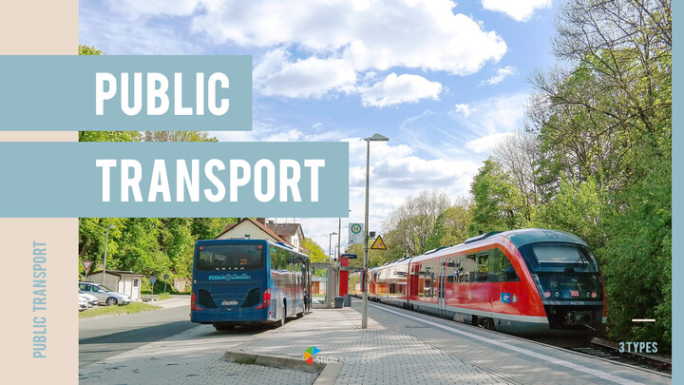
The Road to Efficiency: Analyzing Public Transport ﻿

Slide 3
Introduction
Defining Public Transport Efficiency
Factors Affecting Public Transport Efficiency
Measuring Public Transport Efficiency
Case Studies
Conclusion

Slide 4
Introduction
Good morning, ladies and gentlemen. Today, we will be discussing an issue that affects us all: public transport efficiency. Public transport is the lifeblood of any city, and its efficiency has a direct impact on the quality of life of its residents.
In this presentation, we will explore what public transport efficiency means, why it is important, and how it can be improved. We will also look at case studies of cities that have successfully implemented measures to improve their public transport systems. By the end of this presentation, you will have a better understanding of the challenges facing public transport systems and the strategies that can be used to address them.

Slide 5

Defining Public Transport Efficiency
Public transport efficiency refers to how effectively a city's public transportation system is able to move people from one place to another, while minimizing costs and maximizing benefits. It involves factors such as route planning, frequency of service, and vehicle maintenance.
Efficient public transport systems are important for cities and their residents because they provide an affordable and sustainable mode of transportation that reduces traffic congestion, air pollution, and carbon emissions. They also improve access to employment, education, and other essential services for people who may not have access to a car or other private transportation options.

Slide 6
Factors Affecting Public Transport Efficiency
One of the key factors affecting public transport efficiency is route planning. A well-designed route can significantly reduce travel time and increase the number of passengers served. On the other hand, a poorly planned route can lead to longer travel times, increased congestion, and decreased ridership. It is important for transportation planners to carefully consider factors such as population density, employment centers, and major destinations when designing routes.
Another important factor is the frequency of service. A high-frequency service can reduce waiting times and increase convenience for passengers. However, it also requires more vehicles and drivers, which can be costly. Transportation planners must strike a balance between frequency and cost to ensure that the service is both efficient and financially sustainable. Finally, vehicle maintenance is critical for ensuring that the service operates smoothly and reliably. Regular maintenance can prevent breakdowns and delays, while also extending the lifespan of the vehicles. To achieve maximum efficiency, operators should prioritize preventive maintenance and address any issues promptly.

Slide 7
Measuring Public Transport Efficiency
Public transport efficiency can be measured through various metrics, including passenger load factor and on-time performance. Passenger load factor measures the percentage of seats that are occupied by passengers during a given trip or time period. A higher passenger load factor indicates that more people are using the service, which can lead to increased revenue and reduced costs per passenger. On-time performance, on the other hand, measures the percentage of trips that arrive at their destination on time. This metric is important for ensuring that passengers can rely on the service to get them where they need to go when they need to be there.
To calculate passenger load factor, you divide the number of passengers carried by the total number of seats available. For example, if a bus has 50 seats and carries 40 passengers, the passenger load factor would be 80%. On-time performance is typically calculated by comparing the scheduled arrival time with the actual arrival time. If a bus is scheduled to arrive at a stop at 9:00 am and arrives at 9:10 am, its on-time performance would be 90%.

Slide 8
Case Studies
In Copenhagen, Denmark, the city has implemented a strategy known as the Finger Plan, which involves developing public transport along five 'fingers' extending from the city center. This plan has led to increased ridership and reduced congestion on roads. Additionally, Copenhagen has invested in clean energy buses and expanded bike-sharing programs to further reduce emissions and promote sustainable transportation.
In Curitiba, Brazil, the city has implemented a bus rapid transit system that prioritizes public transport over private cars. The system includes dedicated bus lanes, pre-paid boarding, and integrated ticketing to make the system more efficient and convenient for riders. As a result, Curitiba's bus rapid transit system has become a model for other cities looking to improve public transport efficiency.

Slide 9
Conclusion
In conclusion, we have discussed the importance of public transport efficiency for cities and their residents. By improving factors such as route planning, frequency of service, and vehicle maintenance, cities can provide better transportation options for their citizens.
Measuring public transport efficiency through metrics such as passenger load factor and on-time performance allows cities to evaluate their progress and make necessary improvements. We have also seen case studies of successful strategies implemented by other cities to improve their public transport efficiency.
It is clear that investing in public transport efficiency is not only beneficial for individual commuters, but also for the environment and overall urban development. We encourage all of you to support efforts to improve public transport efficiency in your own communities.

